Slide 1

Counting & Claiming
2025 – 2026
3.21.2025

Slide 2




Overview & Purpose
This training will provide updated procedures for counting and claiming meals in the 2025 – 2026 school year.
The purpose of this training is to identify and understand the following:
Universal Meals
Medium of Exchange and Cash Collection
Benefit Issuance Documents (Rosters)
Point of Service (POS) Failure Solutions

Slide 3


UNIVERSAL MEALS
California has become the first state to implement a statewide
Universal Meal Program for all school children.
California’s Universal Meal Program is designed to build on the foundations of the federal National School Lunch Program (NSLP) and School Breakfast Program (SBP).

Slide 4
INTEGRITY PLAN
LAUSD Food Services Division (FSD) has established procedures to affirm meal counts to support reimbursement.
The Food Service Manager (FSM) will use the BIC Meal Count Consolidation Form for meal periods with more than one meal count sheet
The FSM will run a weekly Meal Counts Summary Report in Newton to check for accuracy
The Area Food Services Supervisors (AFSS) will conduct a minimum of two meal count monitoring's per site before December 15, 2025, and May 15, 2026

Slide 5



MY SCHOOL BUCKS
LAUSD has transitioned from MyPaymentsPlus to MySchoolBucks.
  Funds will be automatically transferred from MyPaymentsPlus to new accounts on MySchoolBucks.
  Students and staff can use funds on their MySchoolBucks account to purchase a la carte items
  Create a MySchoolBucks account to add funds
Download the app or visit the MySchoolBucks website
Create a user profile by adding the student's information
Cafeterias will continue to process cash transactions

Slide 6
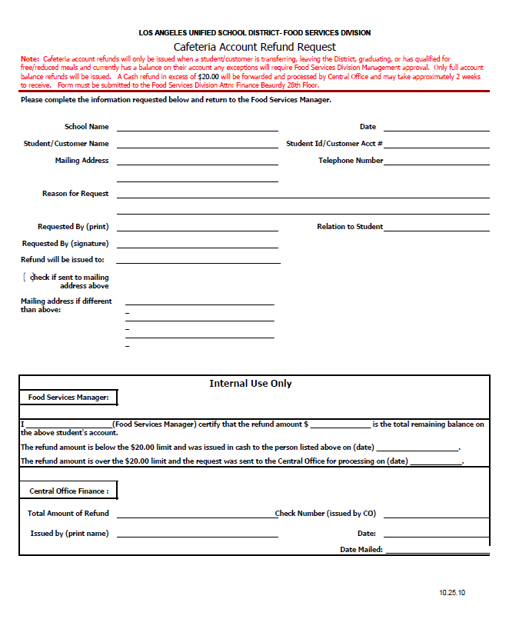
REFUND REQUESTS
Requests for refunds require a completed Cafeteria Account Refund Request Form. The form is available on the Café LA website under Parent Resources.
MyPaymentPlus account holders can submit the completed Cafeteria Account Refund Request Form via:
    Email: mycafelarefund@lausd.net
    or
    Mail:
    LAUSD Finance
    333 S Beaudry Ave.
    Los Angeles, CA 90017

Slide 7



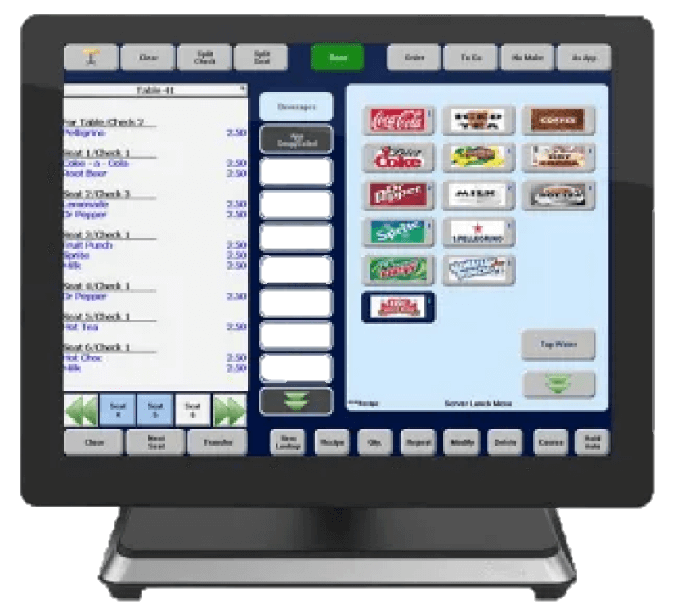
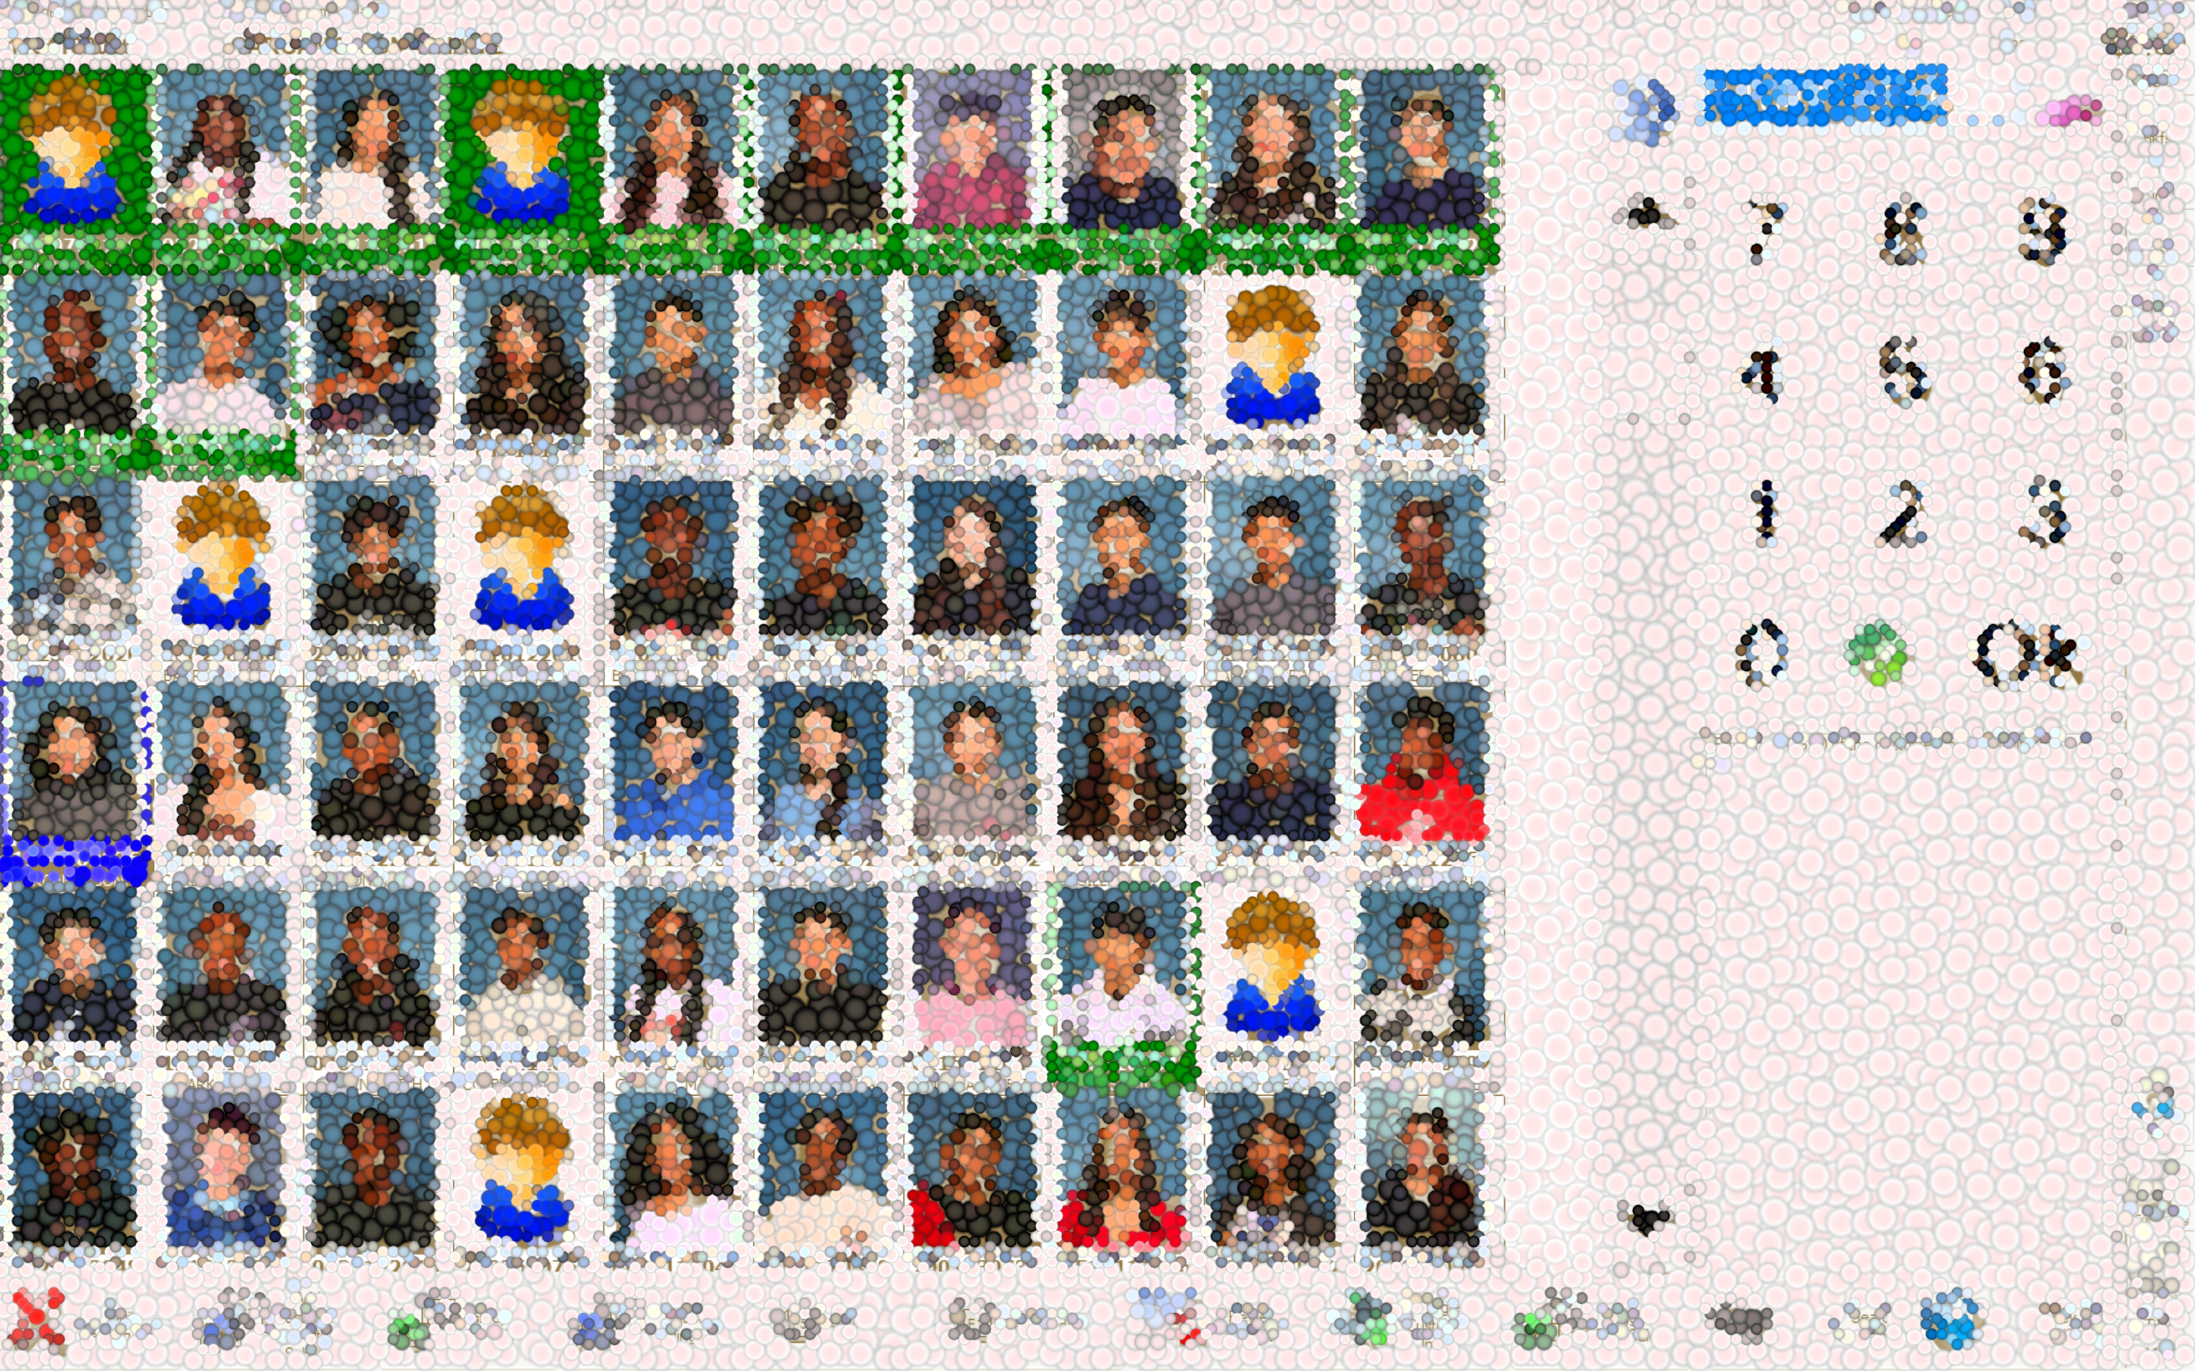
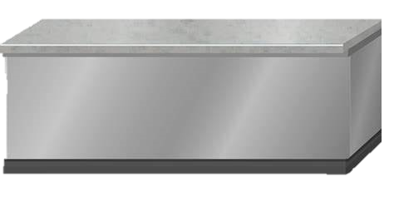


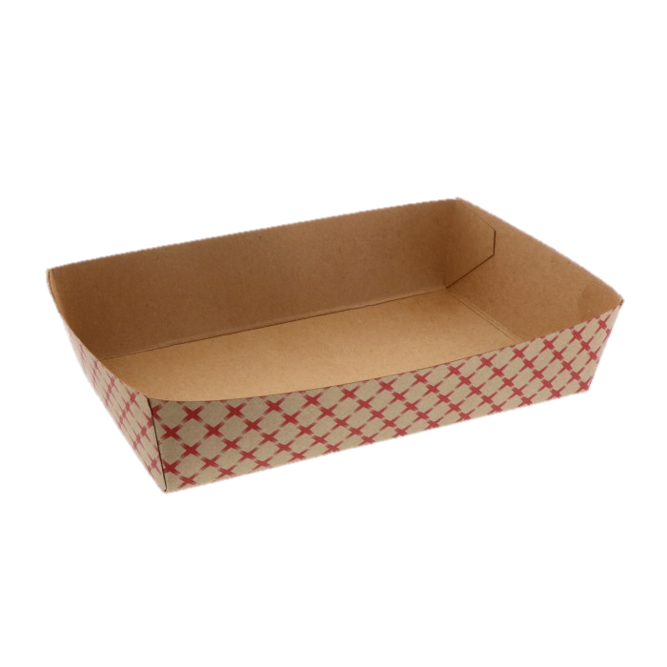



BREAKFAST
MEDIUM OF EXCHANGE

Slide 8
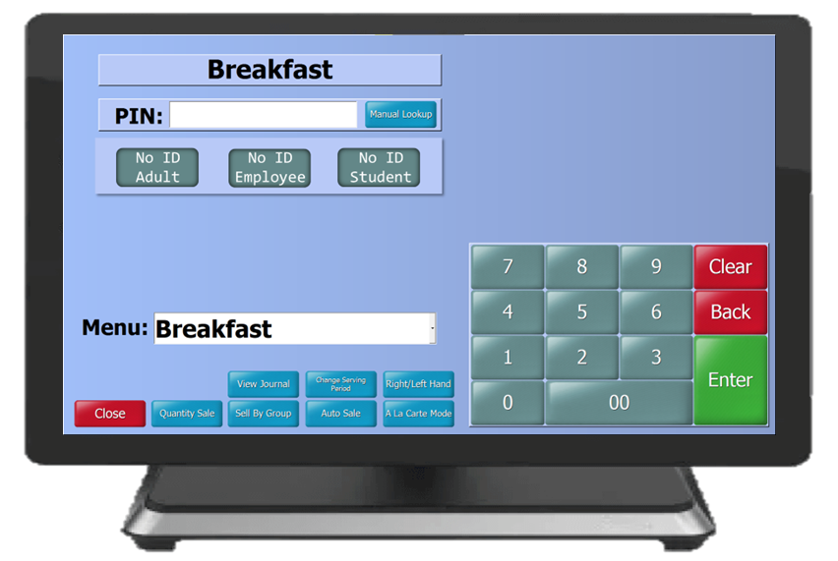
ELEMENTARY
BREAKFAST MEDIUM OF EXCHANGE
Breakfast meal counts are claimed according to the following counting and claiming method, per meal service model for elementary sites.
Cafeteria Service
FSD staff will claim student identification by homeroom or manual look up button at the POS using NEWTON.
Breakfast in the Classroom
Daily Meal Count Form
Meal Consolidation Form

Slide 9
SECONDARY
BREAKFAST IN THE CLASSROOM (BIC)
MEDIUM OF EXCHANGE
BIC meal counts are claimed according to the following counting and claiming method.
Breakfast in the Classroom
Daily Meal Count Form
Meal Consolidation Form

Slide 10
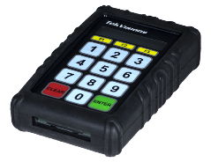
HIGH SCHOOL
MEDIUM OF EXCHANGE BREAKFAST
During the grace period* from August 14th through September 12th, breakfast meal counts are claimed according to the following counting and claiming method.
Cafeteria Service and Mobile Cart
Students say their first and last name and press “9” and “ENTER” on the pin pad to claim meal.
GRACE PERIOD
*Counting and claiming will change after the grace period ends.

Slide 11
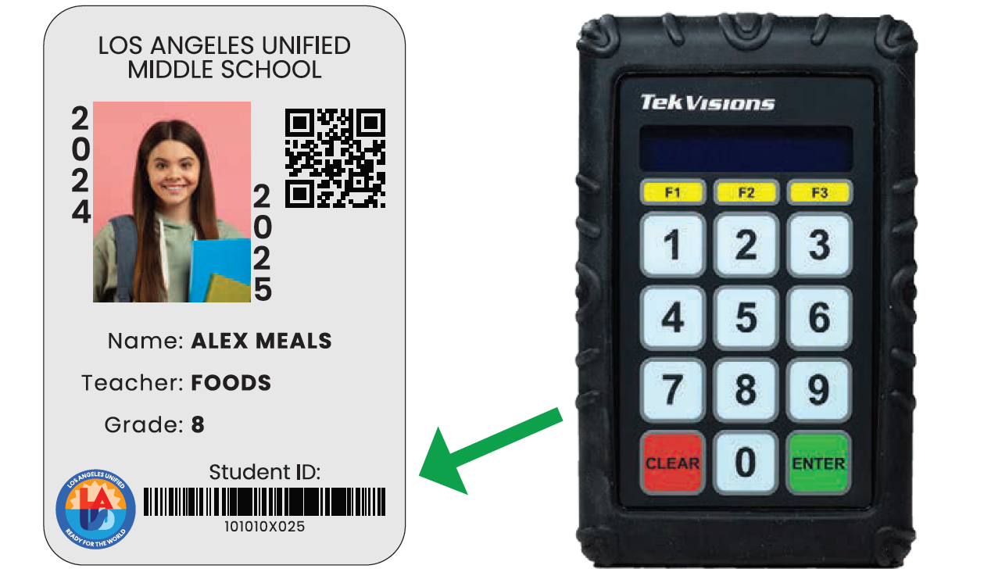
HIGH SCHOOL SITE PIN NOTIFICATIONS
Monday, September 8, 2025
FSM will print Newton Barcode Letter Notifications
Tuesday, September 9, 2025
FSM will distribute Newton Barcode Letter Notifications to homerooms
Effective September 15th students will enter a student PIN or scan a student ID to move through the line faster and enjoy a delicious meal at no cost!

Slide 12

HIGH SCHOOL
MEDIUM OF EXCHANGE BREAKFAST
Effective September 15, 2025 – breakfast meal counts are claimed according to the following new counting and claiming process.
NEW
PROCESS
Cafeteria Service and
Mobile Cart
Scan student ID
Enter student PIN
Student lookup

Slide 13
MIDDLE SCHOOL
MEDIUM OF EXCHANGE BREAKFAST
During the grace period* from August 14th through October 3rd, breakfast meal counts are claimed according to the following counting and claiming method.
Cafeteria Service and Mobile Cart
Students say their first and last name and press “9” and “ENTER” on the pin pad to claim meal.
GRACE PERIOD
*Counting and claiming will change after the grace period ends.

Slide 14
MIDDLE SCHOOL SITE PIN NOTIFICATIONS
Monday, September 29, 2025
FSM will print Newton Barcode Letter Notifications
Tuesday, September 30, 2025
FSM will distribute Newton Barcode Letter Notifications to homerooms
Effective October 6th students will enter a Student PIN or scan a student ID to move through the line faster and enjoy a delicious meal at no cost!

Slide 15
MIDDLE SCHOOL
MEDIUM OF EXCHANGE BREAKFAST
Effective October 6, 2025 – breakfast meal counts are claimed according to the following new counting and claiming process.
NEW
PROCESS
Cafeteria Service and
Mobile Cart
Scan student ID
Enter student PIN
Student lookup

Slide 16

CLAIMING CONNECTION 1
.
What breakfast medium of exchange is utilized at your school?

Slide 17



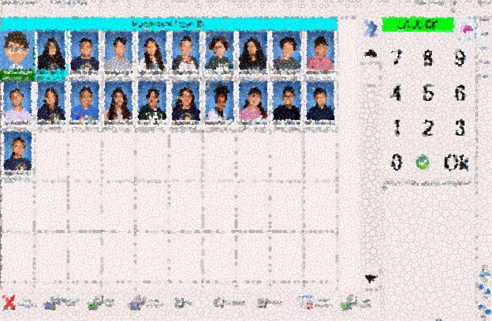
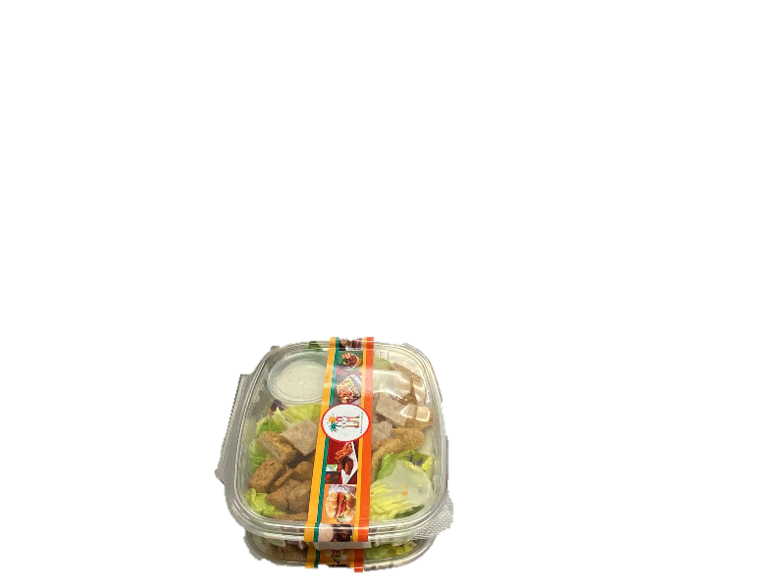
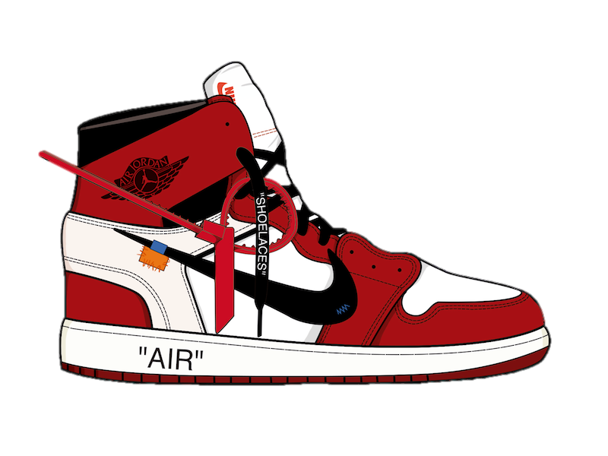
LUNCH MEDIUM OF EXCHANGE

Slide 18

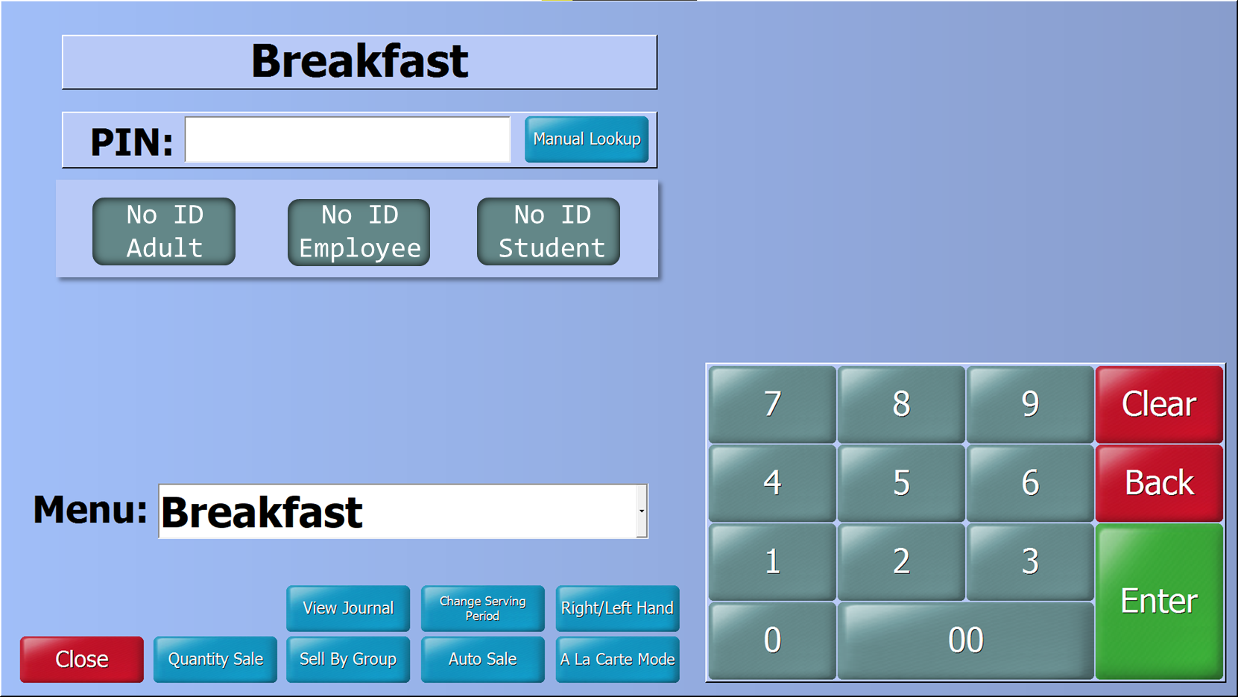
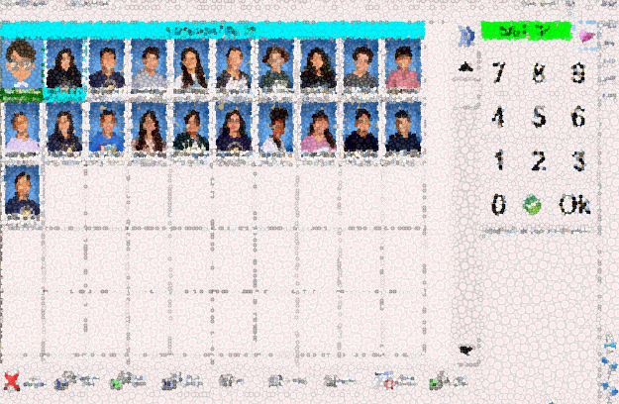

ELEMENTARY
LUNCH MEDIUM OF EXCHANGE
Students enter the meal service lines by classroom and state their names while at the POS. This exchange helps with accurate meal counts, gives the cashier time to identify a reimbursable meal, and prevents students from receiving more than one reimbursable meal.

Slide 19



GRACE PERIOD
SECONDARY
LUNCH MEDIUM OF EXCHANGE
Lunch meal counts are to be conducted according to the following counting and claiming method, per meal service model.
FS staff will ensure a reimbursable meal is selected before claiming the meal
If a reimbursable meal was not selected, verbally ask the student to take another item
If a reimbursable meal is not selected, charge items as
A-la-carte
Student say first and last name, simultaneously pressing
“9” and “ENTER” on pin pad to claim a reimbursable meal
*Counting and claiming will change after grace period ends

Slide 20
NEW
PROCESS
HIGH SCHOOL
LUNCH MEDIUMS OF EXCHANGE
Pin numbers will go live on September 15, 2025. FSD will use the following mediums of exchange at secondary sites.
FS staff will ensure a reimbursable meal is selected before claiming the meal
If a reimbursable meal was not selected, verbally ask the student to take another item
If a reimbursable meal is not selected, charge items as
a la carte
Students have three ways to claim a reimbursable meal;
Scan student ID, enter student PIN or student look up

Slide 21
NEW
PROCESS
MIDDLE SCHOOL
LUNCH MEDIUMS OF EXCHANGE
Pin numbers will go live on October 6, 2025. FSD will use the following mediums of exchange at secondary sites.
FS staff will ensure a reimbursable meal is selected before claiming the meal
If a reimbursable meal was not selected, verbally ask the student to take another item
If a reimbursable meal is not selected, charge items as
a la carte
Students have three ways to claim a reimbursable meal;
Scan student ID, enter student PIN or student look up

Slide 22
COUNTING & CLAIMING
PROCEDURES FOR BIC
BIC sites will use the total meal counts from the Breakfast Daily Meal Count Consolidation form to input counts into the
“Post Operating Day” in Newton Front of the House (FOH).
Verify that all classroom Breakfast Meal Count Forms have been collected and inputted onto the BIC Daily Meal Count Consolidation Form before entering counts into “Post Operating Day”
Collect all Breakfast Meal Count Forms
Input counts onto BIC Daily Meal Consolidation form

Slide 23
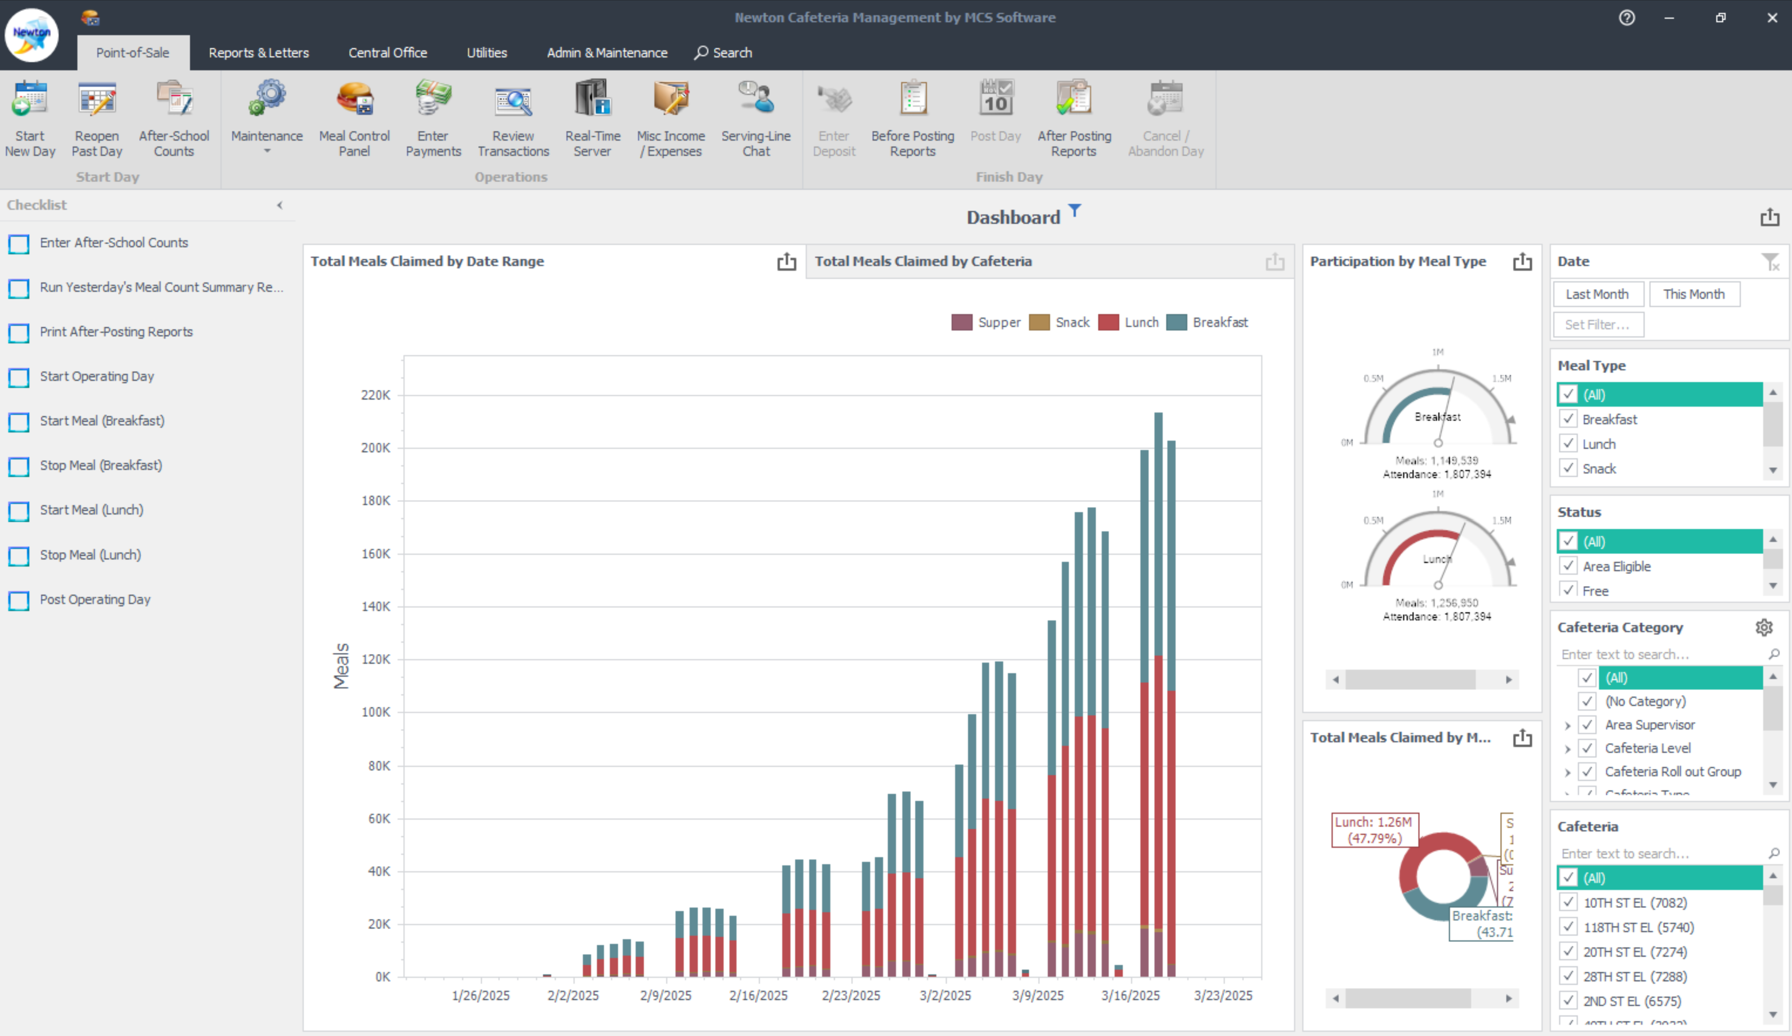
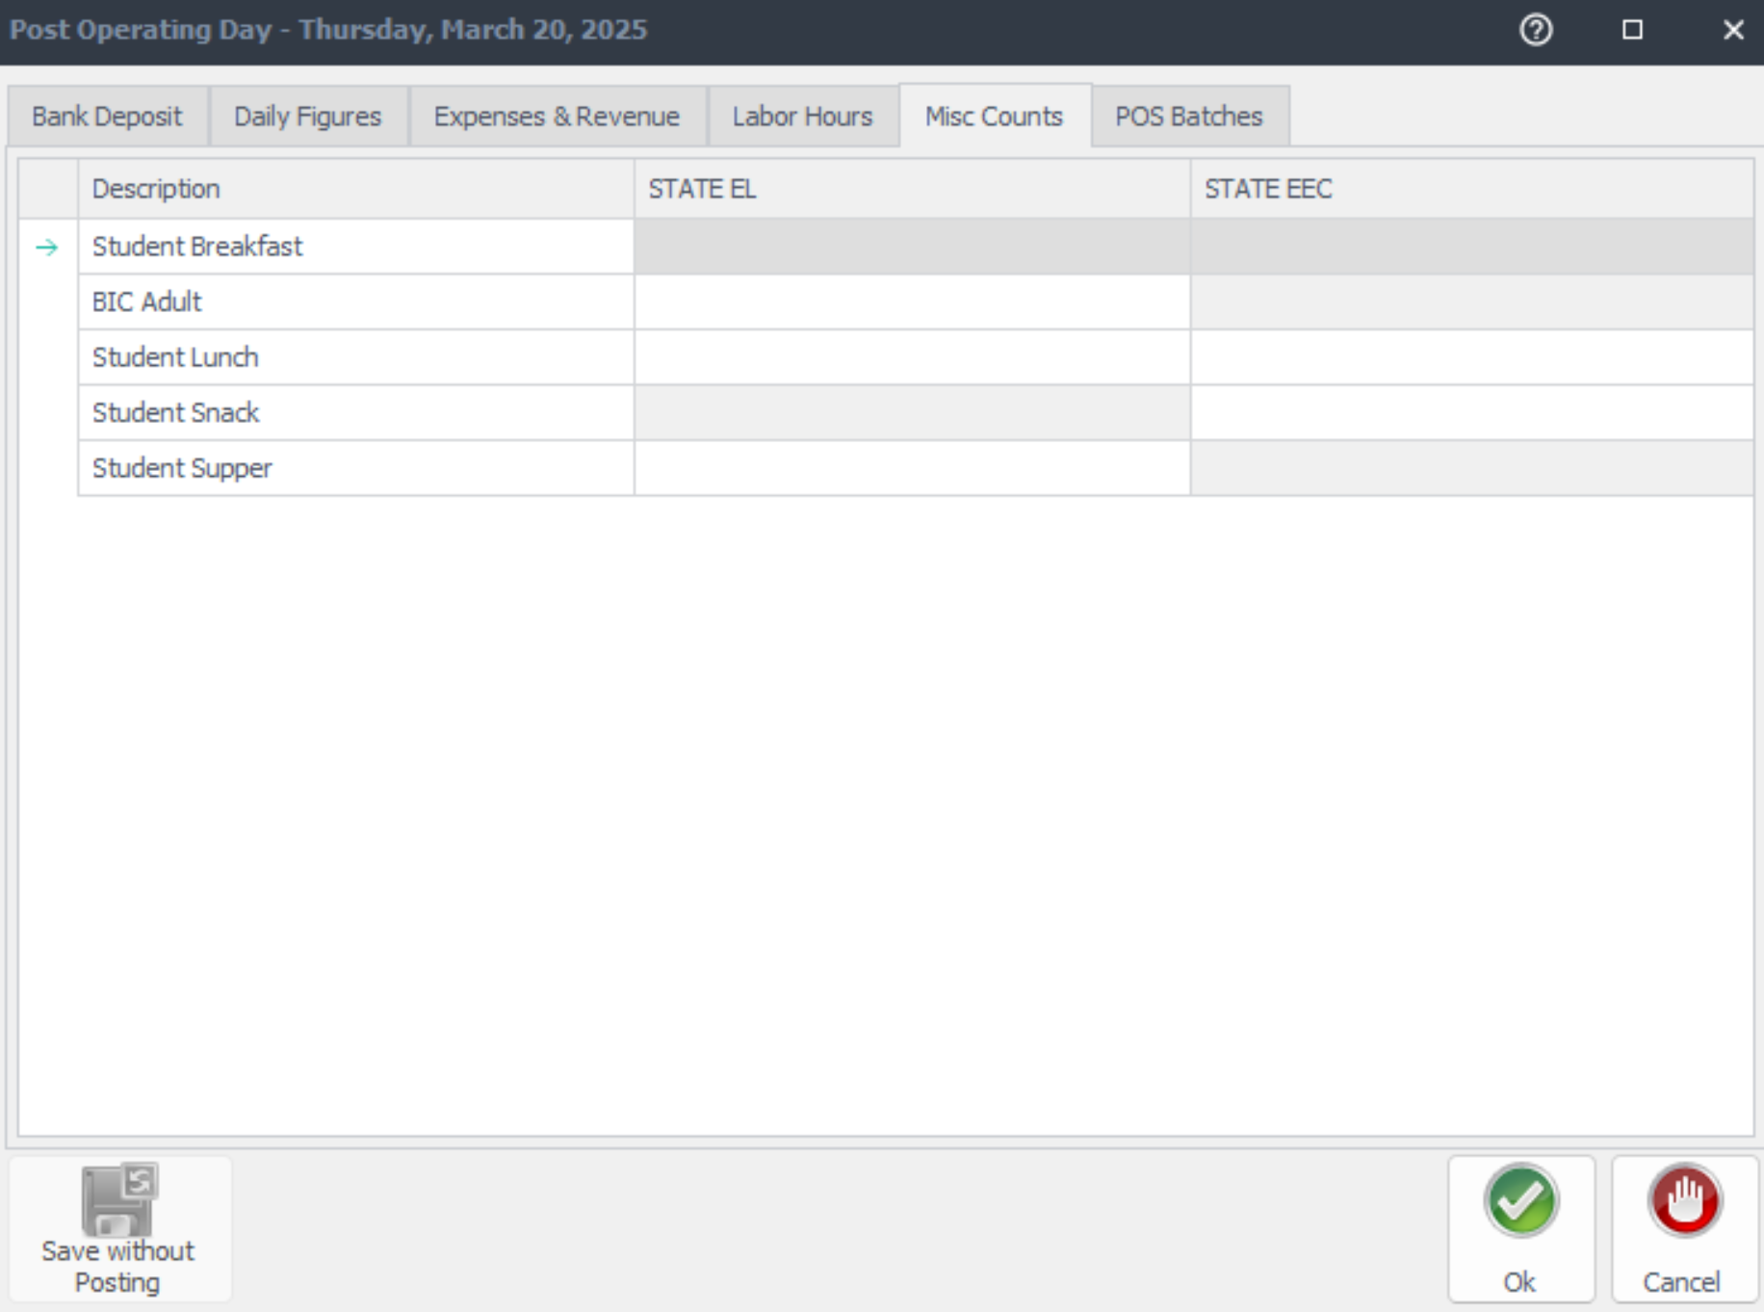

NEWTON FRONT OF THE HOUSE
777
9
At the end of the day gather the BIC Meal Count Forms and BIC Consolidation Form and enter counts into “Post Operating Day” in the tab “Misc Counts” using Newton FOH.

Slide 24
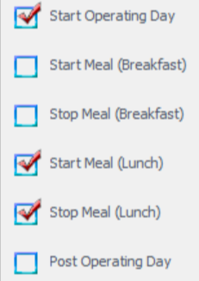
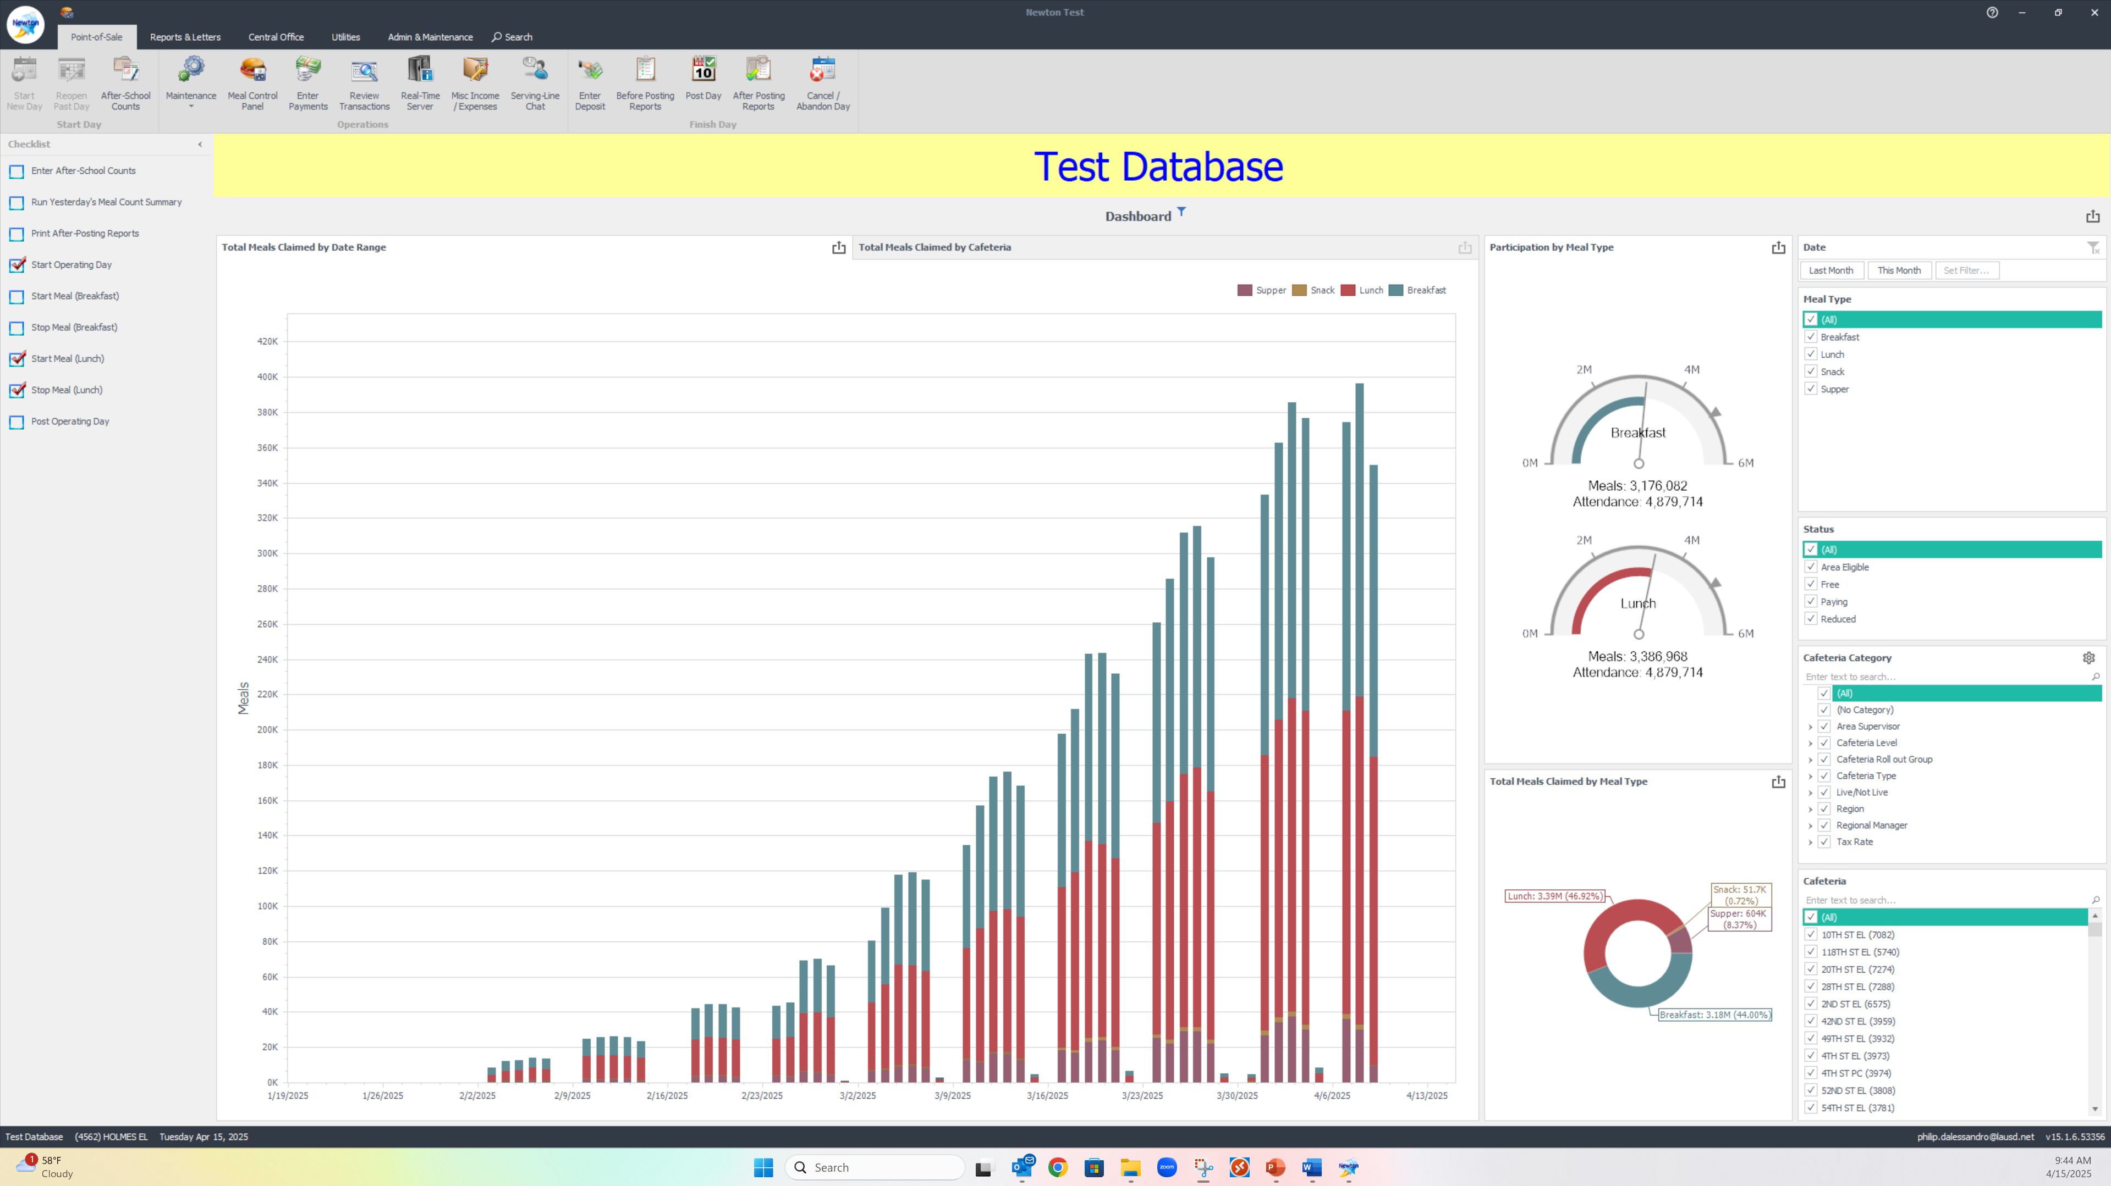
POST OPERATING DAY
777
9
Click on
“Post Operating Day” at the end of the days service to enter the
BIC Meal Counts.

Slide 25
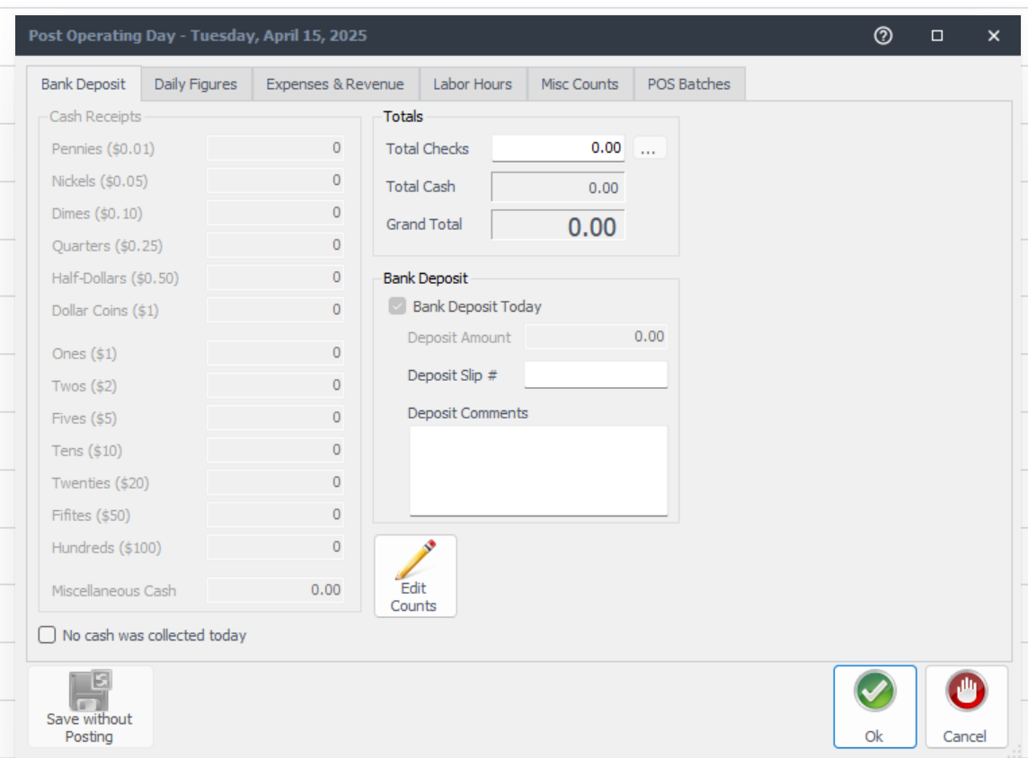
BANK DEPOSIT & DAILY FIGURES
The first pop up in post operating day will be the “Bank Deposit” tab. Complete the:
“Bank Deposit” tab and “Misc Count” tab before completing the “Daily Figures” tab.

Slide 26
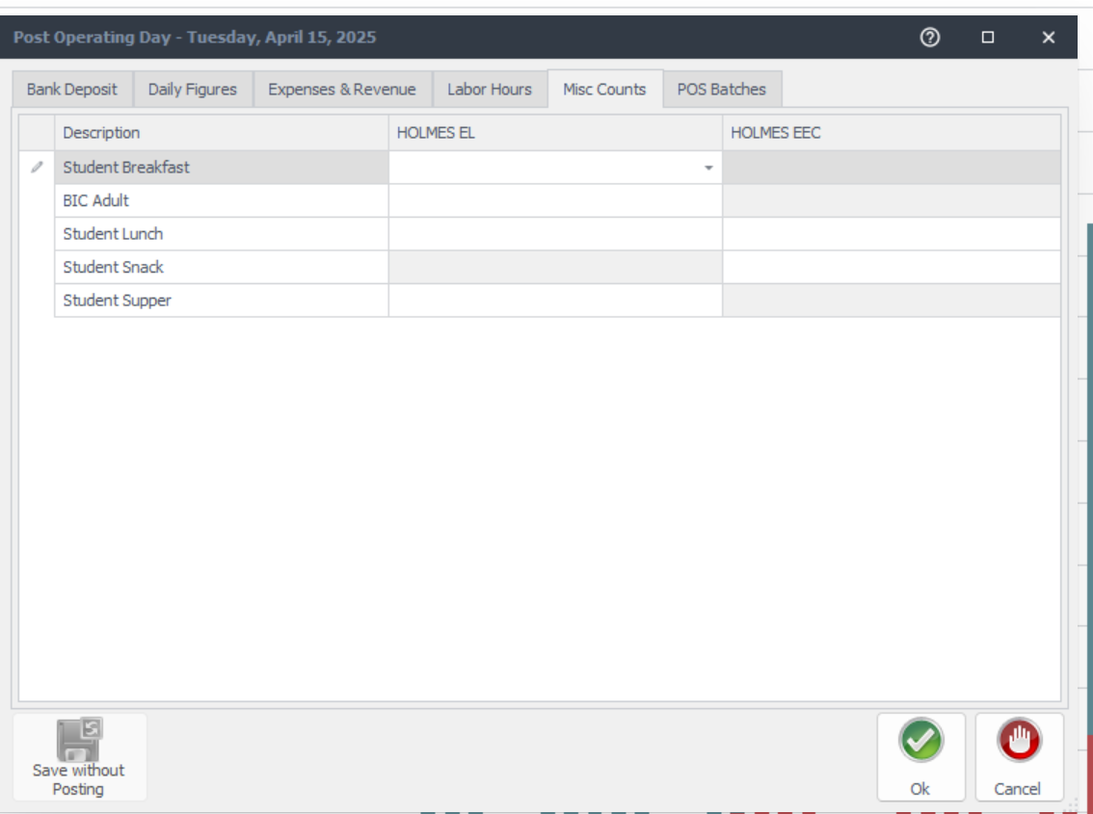
MISC COUNTS
  The “Misc Counts” tab will be where you input BIC meal counts from the BIC Meal Count Form and BIC Meal Count Consolidation Form. Teacher BIC meals are entered under BIC Adult and student BIC meals are under Student Breakfast.

Slide 27
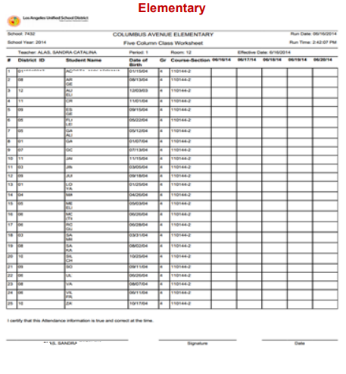

COUNTING & CLAIMING
PROCEDURES FOR CSPP
California State Preschools Programs (CSPP) will use classroom rosters to account for student meals.
Claim meals in Newton at end of day by selecting “Post Operating Day” and inputting Breakfast and Lunch Counts into “Misc Counts Tab”
Verify the correct meal category and CSPP site
77
89

Slide 28



OFF-SITE AND CONTINUTATION-SITE PROCEDURES
OFF-SITE

Slide 29
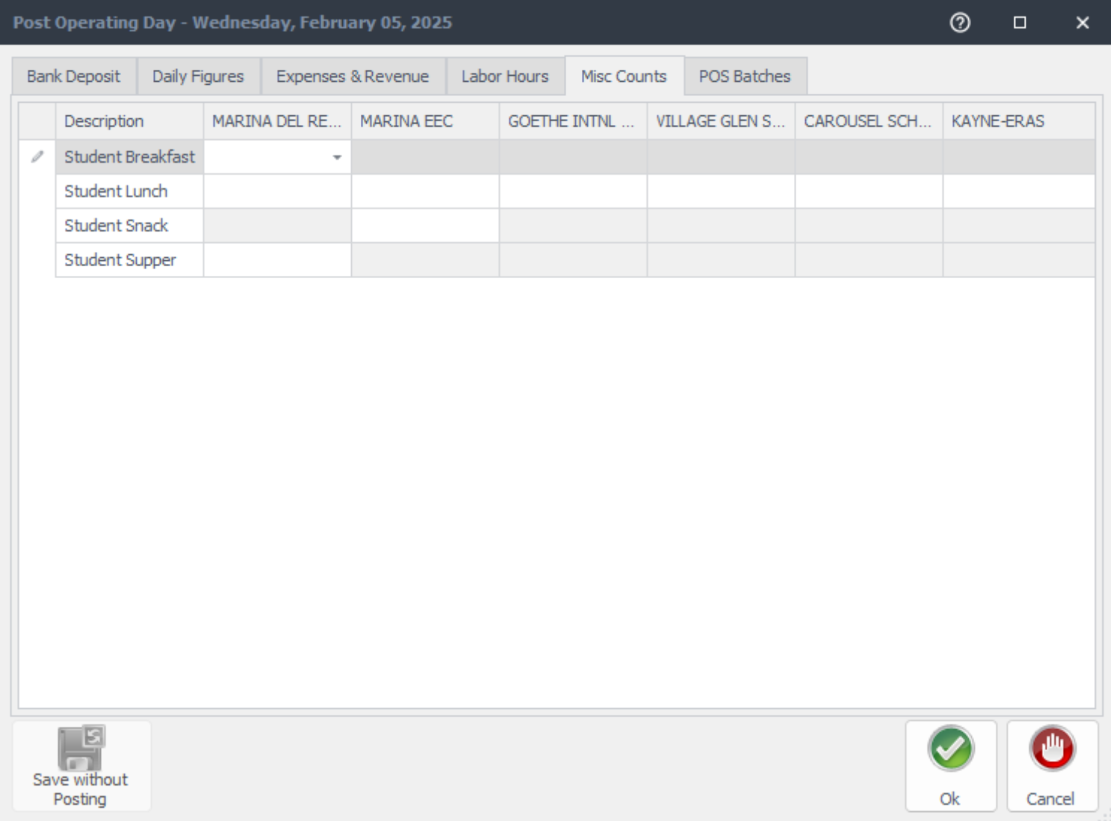
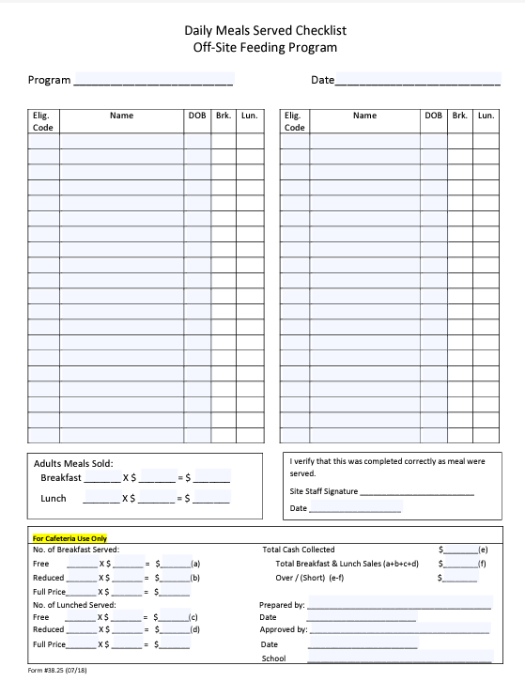
DAILY MEAL SERVED CHECKLIST OFF-SITE FEEDING
To account for meals at off-sites, including continuation-sites, use the Daily Meal Served Checklist Off-Site Feeding Program form.
Students 21 and older pay adult prices
Students 21 and older enrolled in a special-education program qualify for meals at no charge
Meals from continuation and off-sites are claimed in Newton at end of day by selecting “Post Operating Day” and inputting Breakfast and Lunch counts into “Misc Counts” Tab under correct Off-site and meal service.

Slide 30


MISC COUNTS FOR OFF-SITES
Meals for off-sites are claimed at end of day when selecting “Post Operating Day”
Bank Deposit will be entered first
Next select
“Misc Counts” tab to input meal counts for each off-site into the correct site and meal service
45
33
65
11
No Service
34
75
13

Slide 31
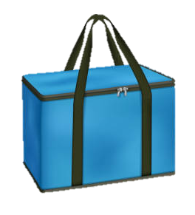
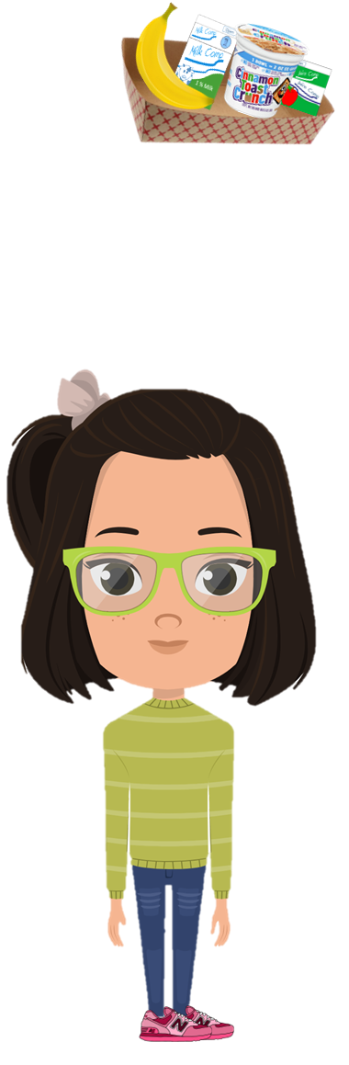


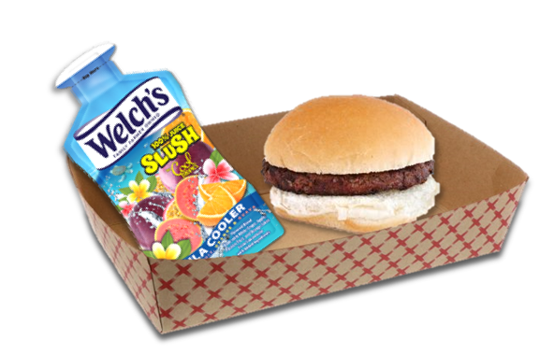
SUPPER

Slide 32
COUNTING & CLAIMING
PROCEDURES FOR SUPPER
Students participating in supper, will give their name in exchange for a meal.
Supper carts will be set up near designated eating areas
Community Rosters will be used to account for meals served to students receiving a meal and not enrolled in an ASP
ASP Supper Grid Sheet will be used to account for enrolled students receiving a meal
Community
ASP

Slide 33
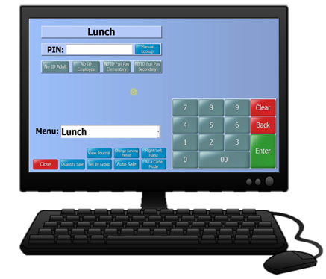
SUPPER ENTRY
After collecting the Community Roster and ASP Supper Grid Sheet, total meals will be tallied and claimed in Newton the next day by selecting “Enter After School”.
Community
+
ASP
80

Slide 34
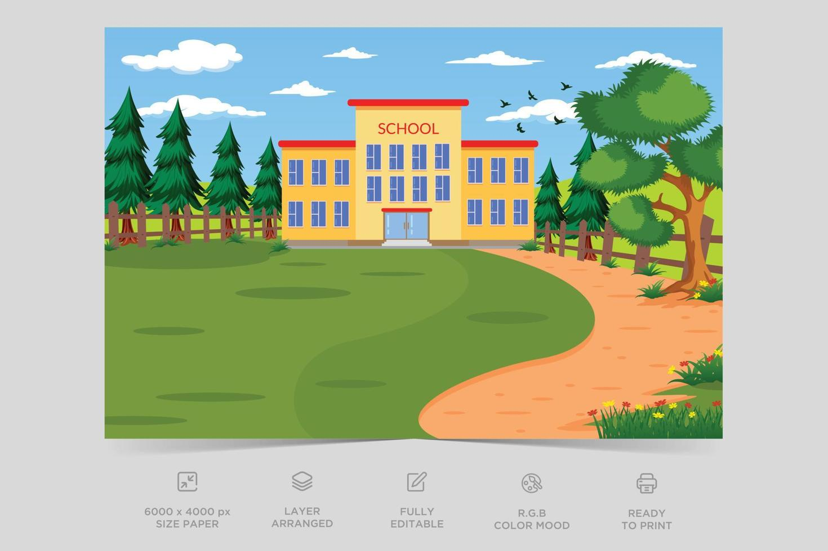



CLAIMING CONNECTION 2
What does the community member participating in supper provide in exchange for a meal?
Their First and Last Name

Slide 35

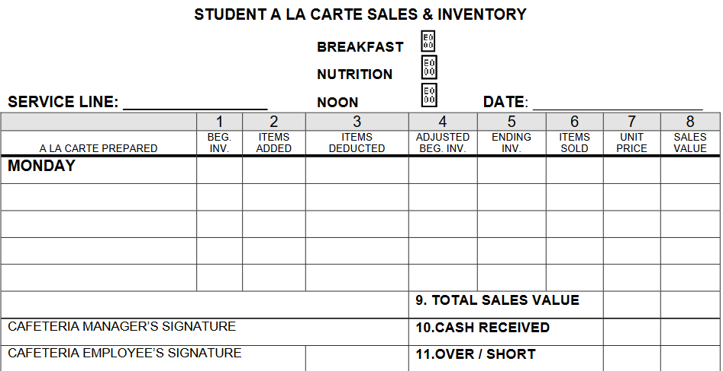



NON-REIMBURSABLE MEALS
A non-reimbursable meal is a meal that does not contain the minimum required number of components. Encourage students to add another component to make the meal reimbursable.
      Cafeterias will have a basket of fruits and cold vegetables at the POS to assist students in making meal selections
      If a student declines, charge items at an a la carte price
      Do not claim as a reimbursable meal

Slide 36







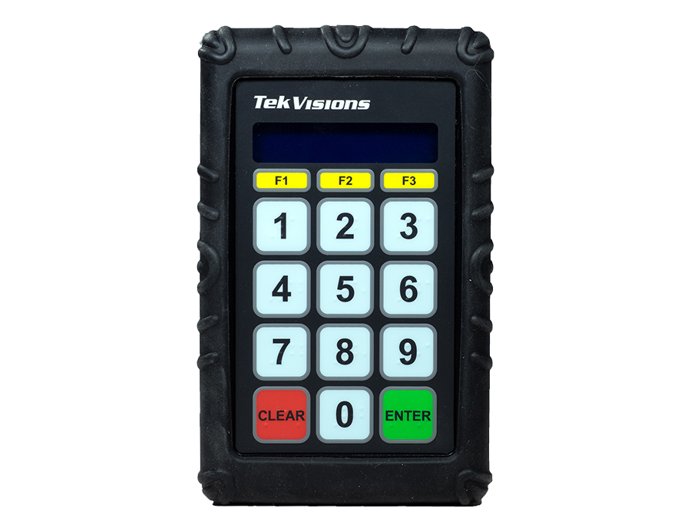



Cafeterias will have a basket of fruits and vegetables at each POS to assist students in completing the meal selection.

Slide 37

What could be included in the basket at the POS to guide students in selecting a reimbursable meal?
CLAIMING CONNECTION 3
Fruits and Vegetables

Slide 38

MEAL BENEFIT ISSUANCE DOCUMENTS
ROSTER MAINTENANCE
Newton and MiSiS Rosters are to be printed monthly on the first of every month. Use the MCS-CMS Finish Line.
CEP
MiSiS Meal Program Roster
Monthly
Newton Student Roster
Monthly
Monthly
1

Slide 39
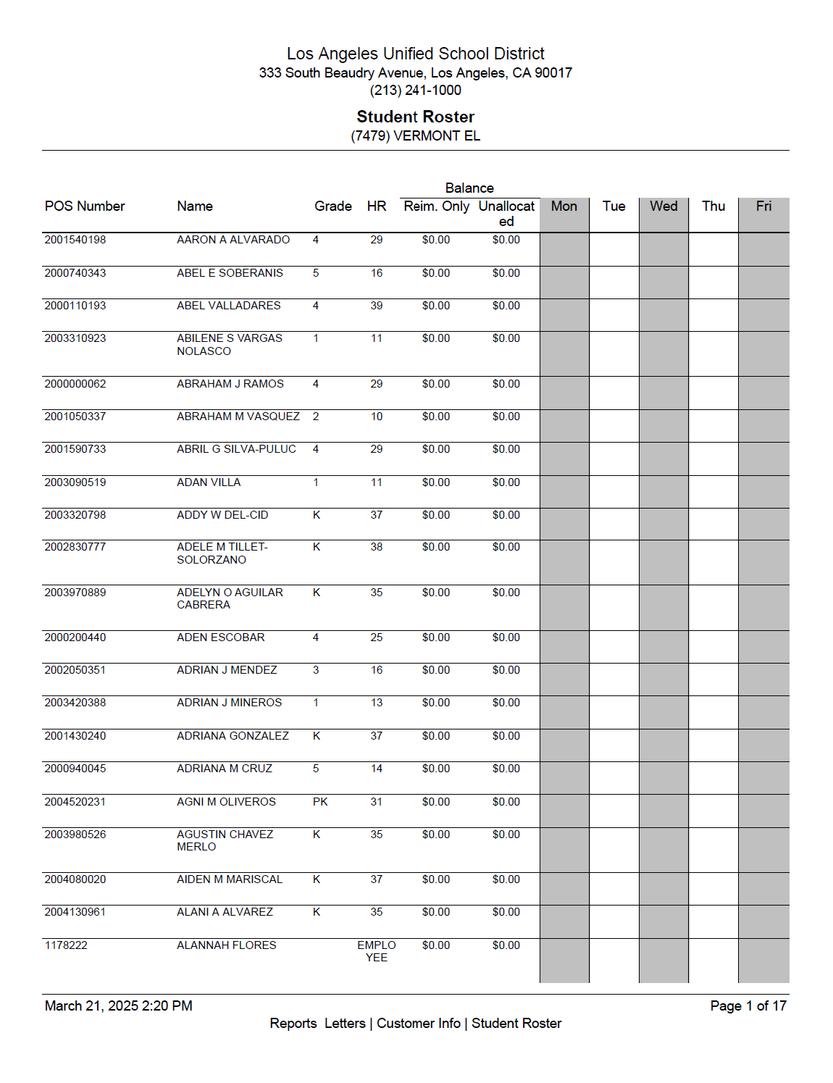
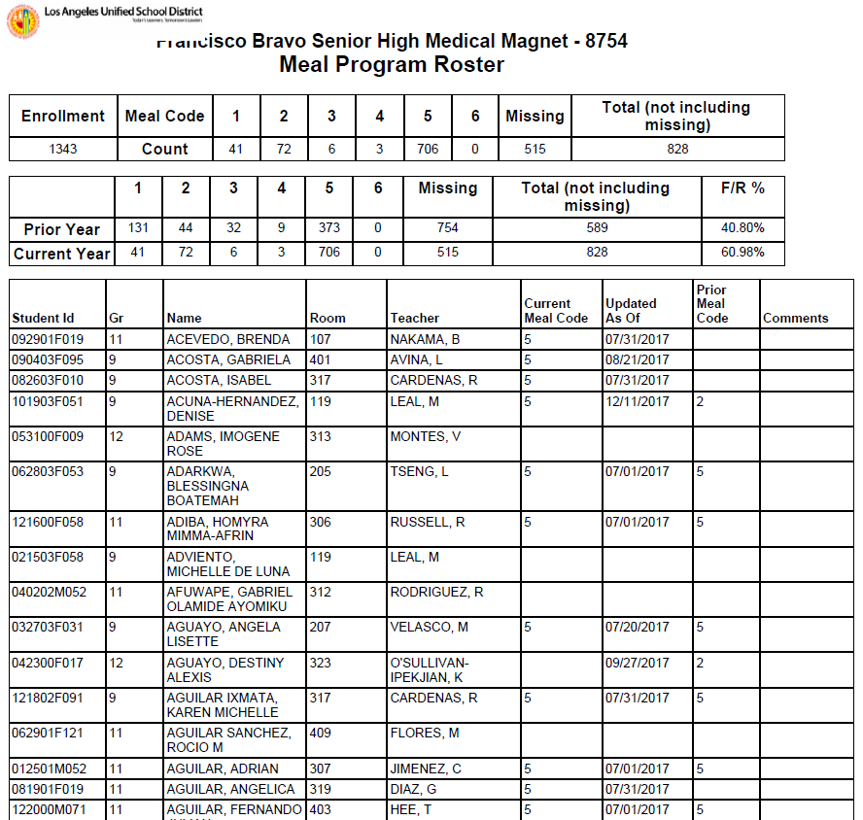
NEWTON AND MISIS ROSTERS
Rosters are a significant component of compliance. Newton Student Roster and MiSiS Roster are printed and retained to ensure accurate student enrollment.
    Print in alphabetical order or by classroom
    Manually write the date range on the roster
    File past rosters with the most current in front
Keep on file for 3 years + the current year.

Slide 40
ACCOUNTABILITY
School Food Authorities (SFA) must have policies and procedures to prevent meal over-and under-claiming. LAUSD implements the following practices as a safeguard to address this issue.
Attendance Factor must be selected for main site and input/update attendance and enrollment for all other sites in “Daily Figures”
Edit Check
Site Monitoring
CAFETERIA

Slide 41

ATTENDANCE FACTOR
Determined by the federal government for the 2025-2026
school year, ADA is 92.1%.
The average daily attendance (ADA) factor accounts for the difference between enrollment and attendance for that school district based on the information submitted in the previous year:
Schools that exceed the 92.1% ADA must annually submit attendance documentation to validate the increase in their daily attendance factor.

Slide 42
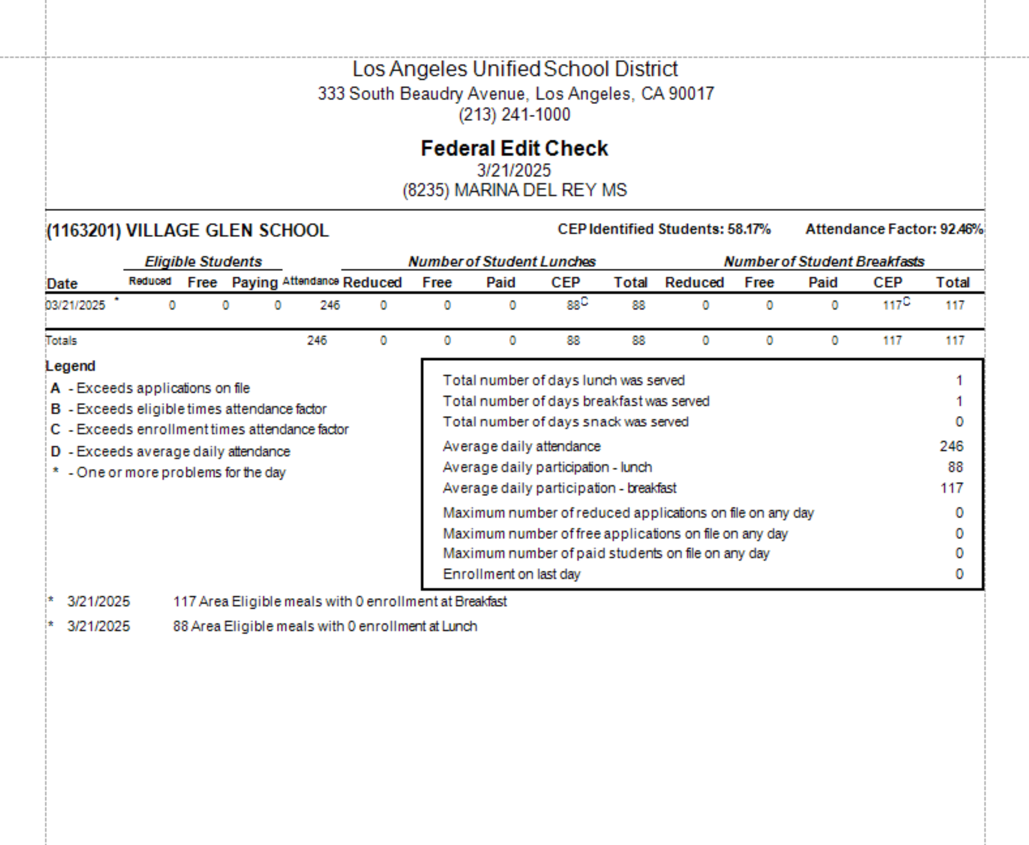
FEDERAL EDIT CHECK
The Federal Edit Check is an accountability process developed to improve accuracy of reimbursement claims by the SFA:
    Only one reimbursement claim
    per meal, per student, per day:
      Breakfast
      Lunch
      Snack
      Supper
    SFAs are required to repay any state/federal over-claimed meals.

Slide 43

SITE MONITORING
ANNUAL ACCUCLAIM
Federal regulations require one on-site review by
January 31st of each year.
  AFSS conducts the review
  The AFSS is given 45 calendar days from the review
  date to follow up on any corrective actions necessary
  SFA’s are required to provide training for employees
  FSD offers the following trainings:
        Annual FSM orientation
        Professional Standards
        New employee training (NET and MCC)
        ServSafe
        Follow up training and monitoring as needed

Slide 44

FSM ANNUAL SITE MONITORING
The FSM is responsible for conducting 2 annual
site monitoring's for CACFP supper program.
    Days of the week and dates must vary
    AFSS will assign a monitoring date to FSM

Slide 45
SPECIAL CIRCUMSTANCES
AND MEAL COUNTS
Special circumstances can affect the current counting and claiming process of utilizing the POS to record meals served. During these circumstances, the Breakfast/Lunch Meal Count Form is used in lieu of the POS:
    Inclement Weather
      Principal requests meals are packed for delivery to Pre-K and Kinder classrooms due to heavy rain
    POS Failure
    Sewage Backup
    Facilities Maintenance
      Cafeteria not available for students and must serve out of auditorium or multipurpose room

Slide 46
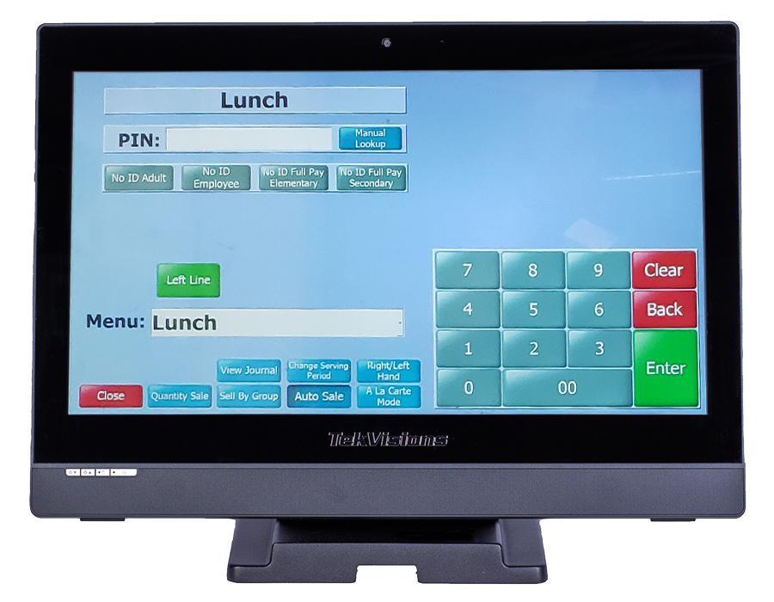

NEWTON POS FAILURE
In the event of a POS failure:
  Submit a ServiceNow Ticket and inform AFSS
  Use Breakfast/Lunch Meal Count Form to account for
  reimbursable meals
  Mark each meal in numerical order with a slash or “X” after a reimbursable meal is served

Slide 47
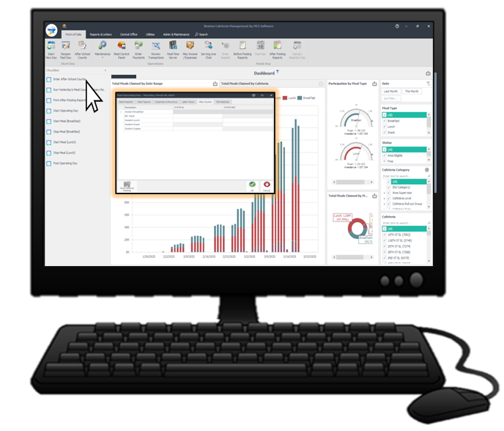
CLAIMING MEALS WHILE POS IS DOWN
Use the manager’s terminal to enter the meals from the service.
If the manager’s computer is also down (due to system or power failure), enter meals when the computer are connected and operable.
Open the terminal for the appropriate serving period
Enter meals served as MISC Counts
    Attach the Breakfast/Lunch Meal Count form to the Production Worksheet

Slide 48

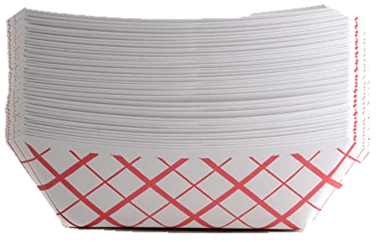
UNACCEPTABLE
MEAL COUNTING METHODS
  The following is a list of common errors in the meal counting process, resulting in non-reimbursable meal claims.
Counts taken anywhere other than the POS
Attendance counts
Tray or entrée counts
Classroom counts
Second meals claimed for reimbursement

Slide 49
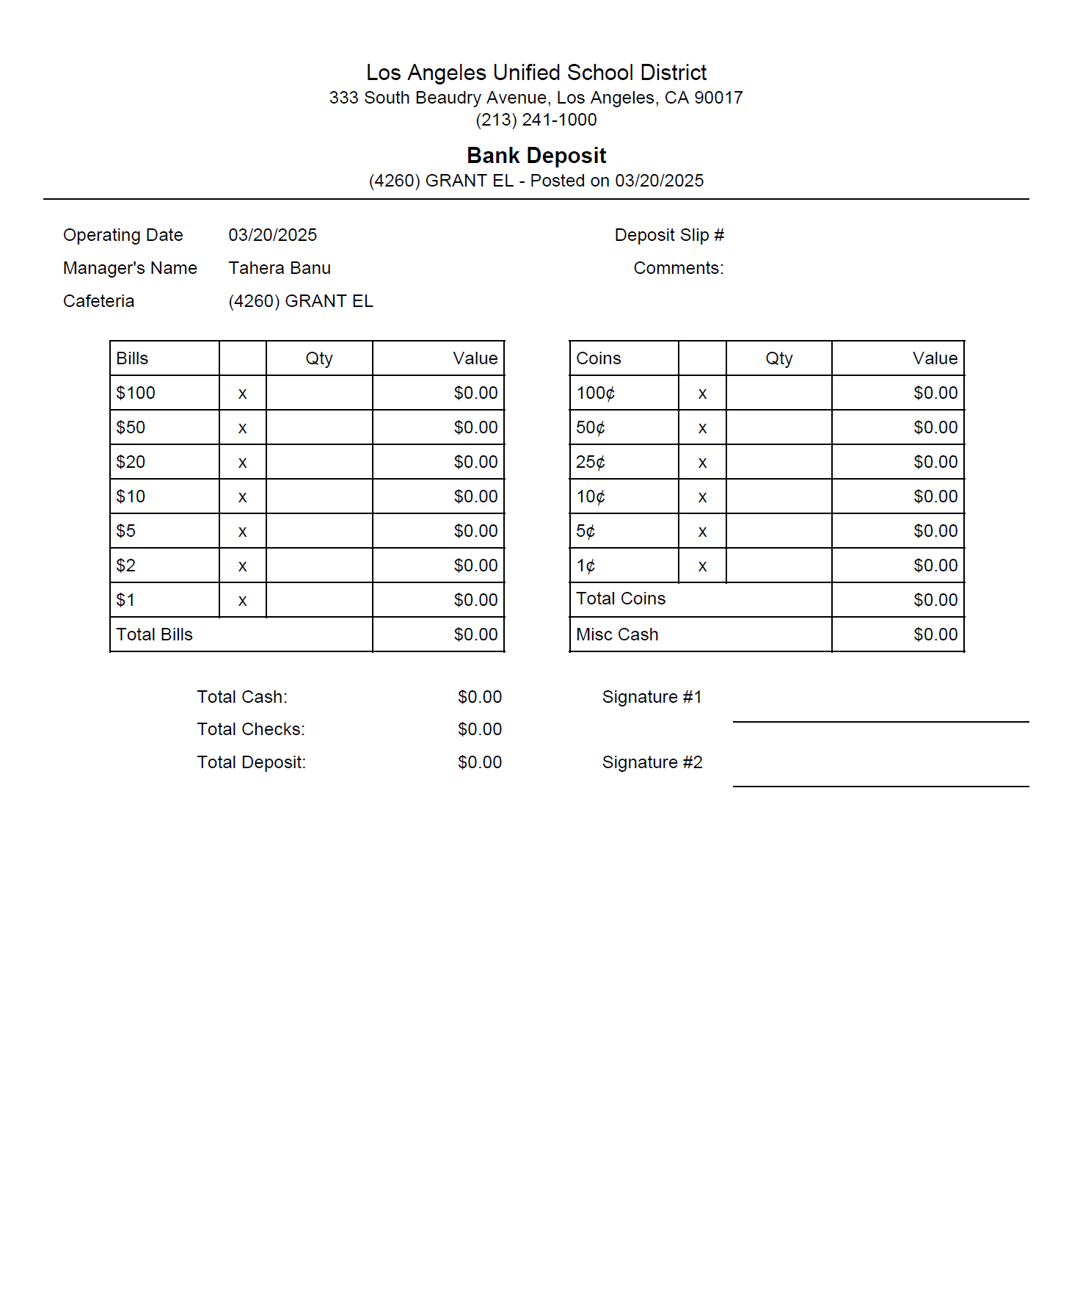
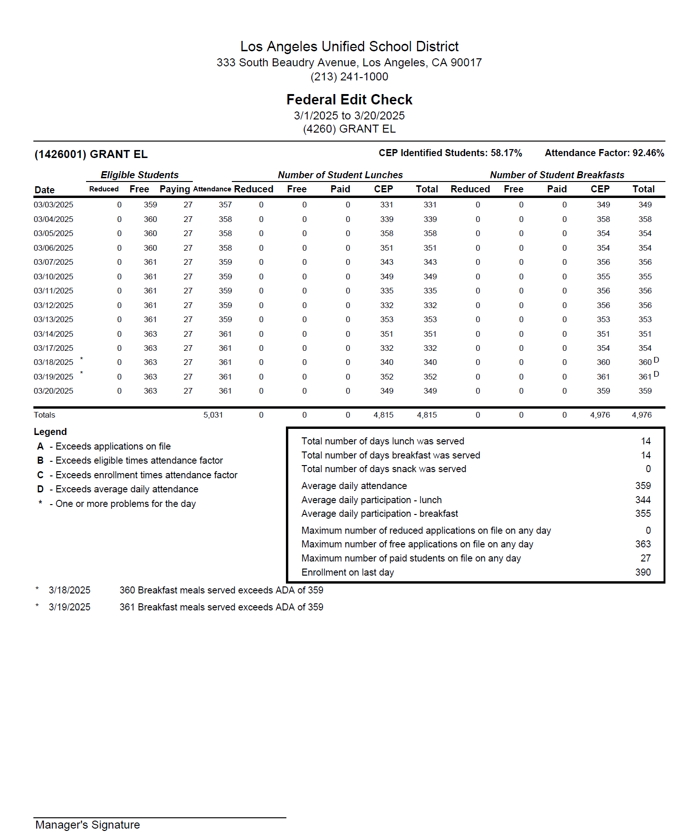
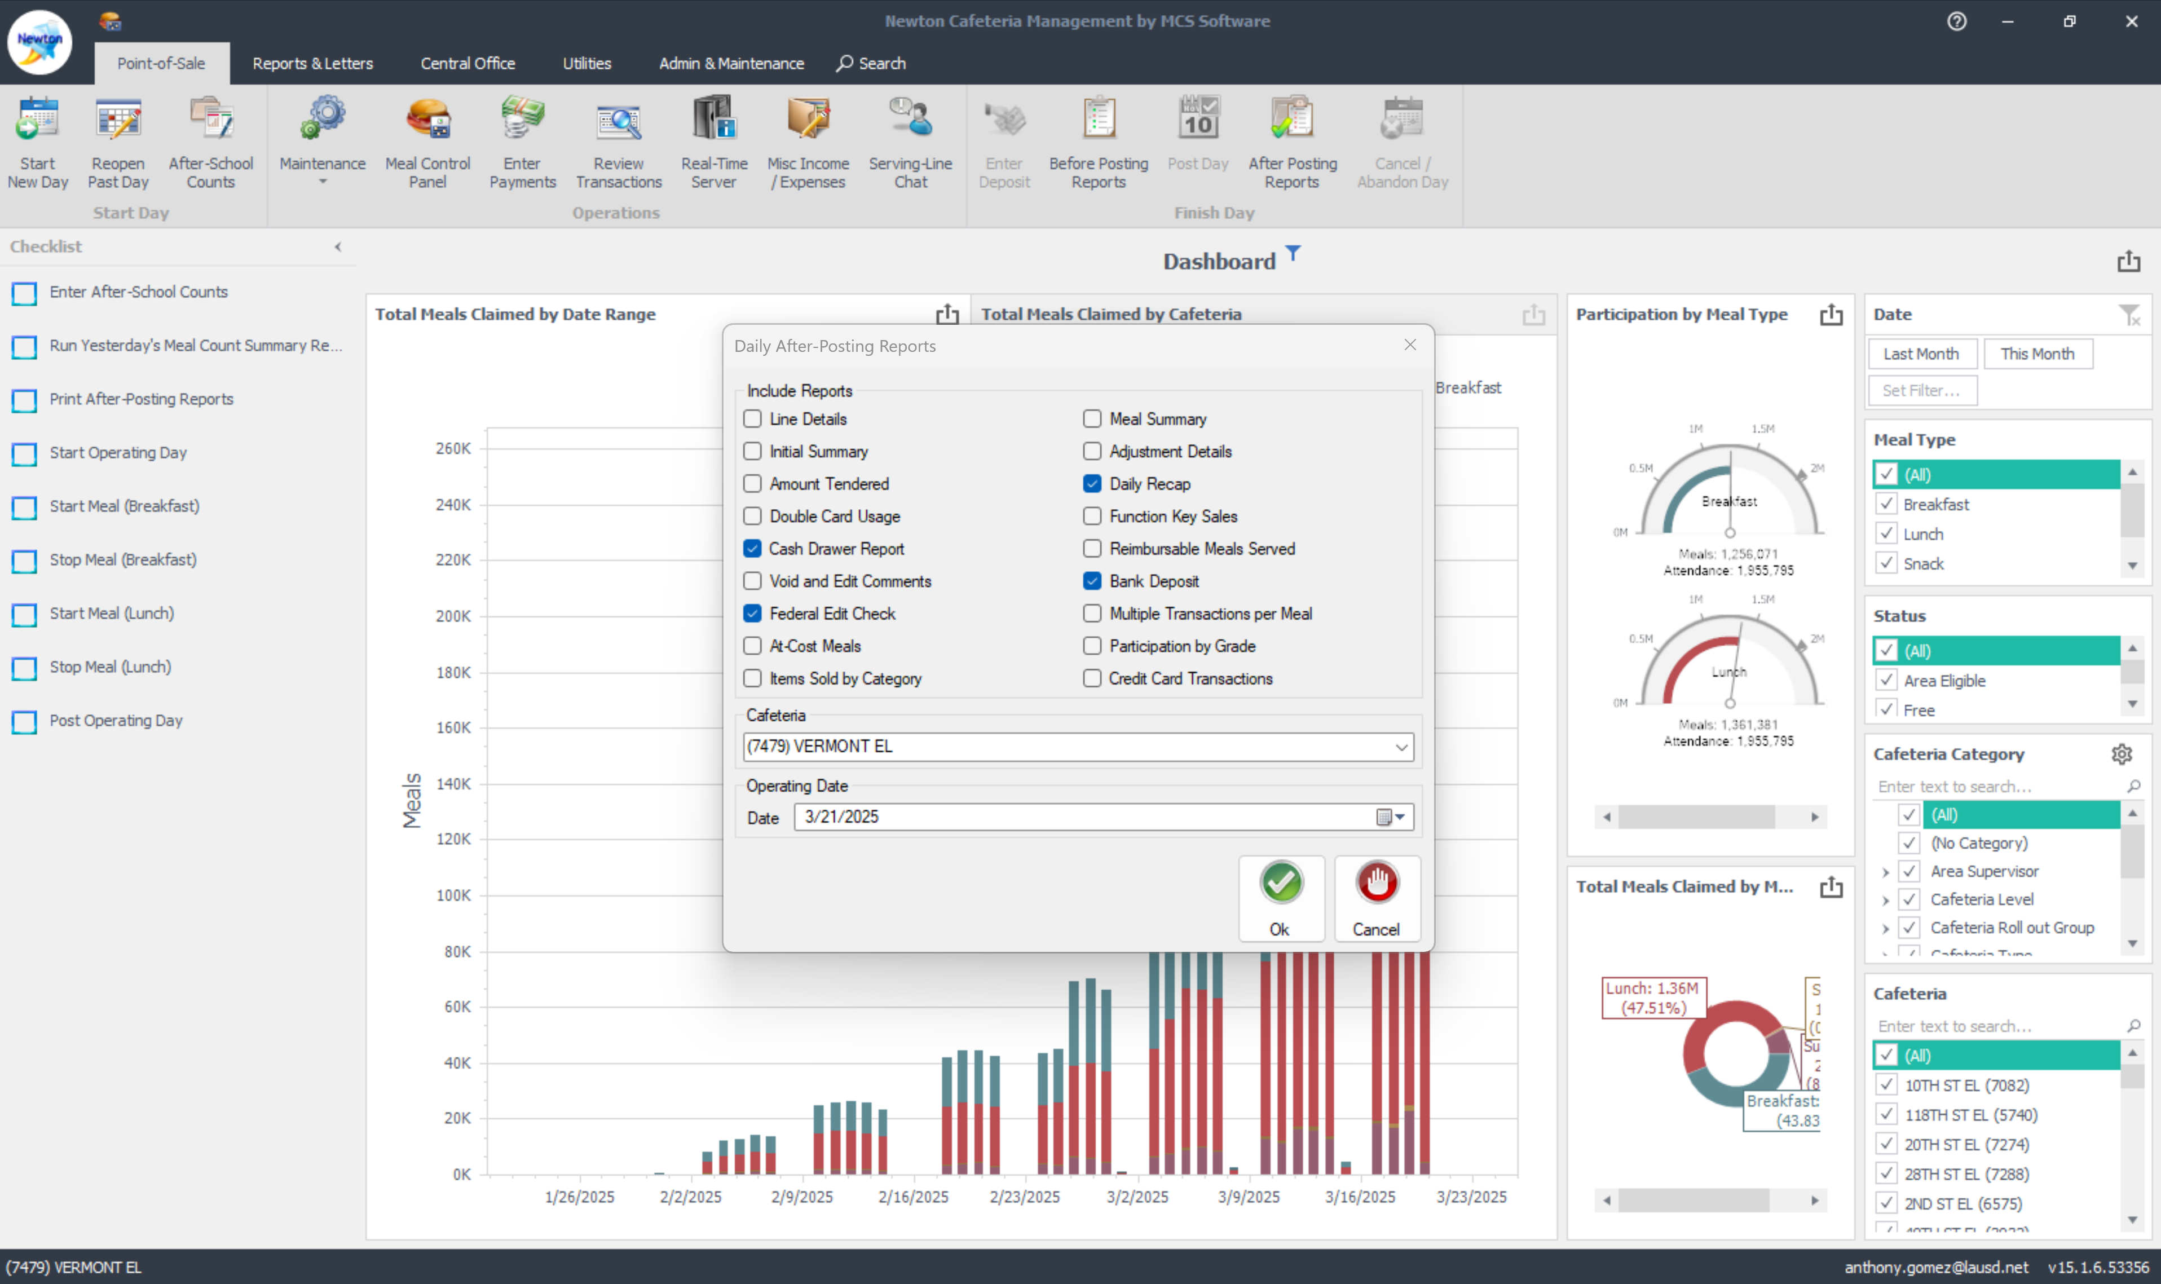
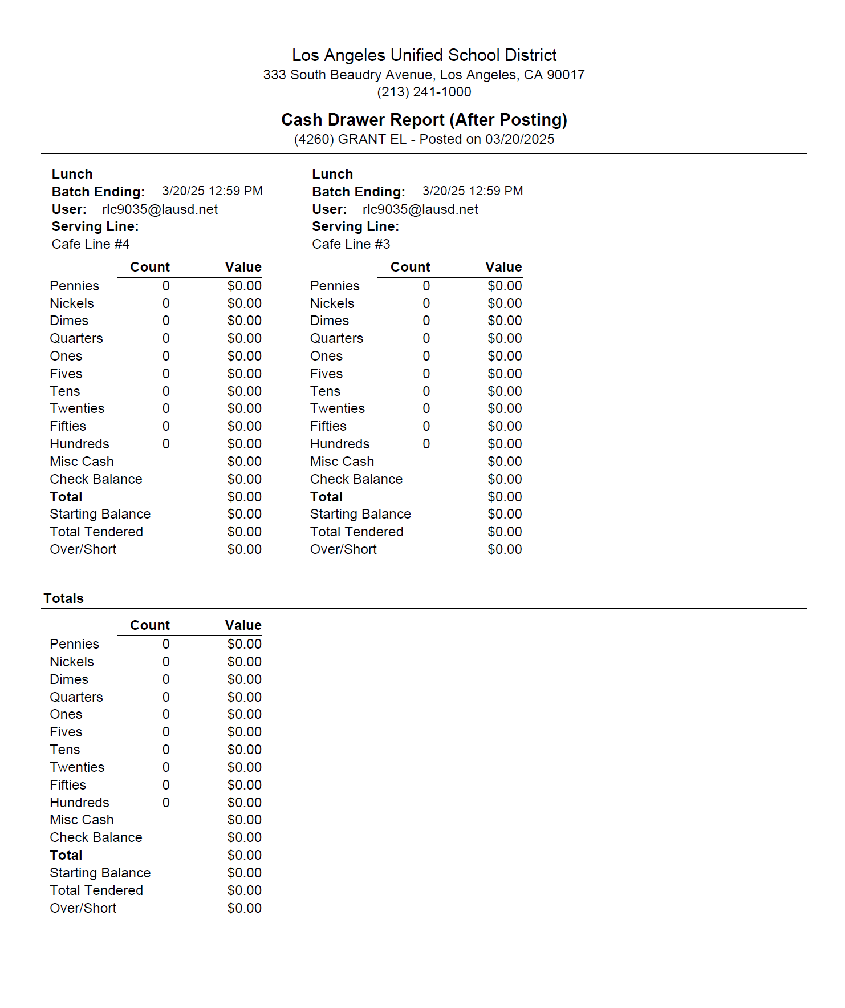
AFTER-POSTING REPORTS
  FSM will run the “After-Posting Reports” at the beginning of the day after entering supper counts. Managers should address any discrepancies in meal counts or variances. After resolving the issue, rerun the reports and save them to the desktop.

Slide 50
Adult and non enrolled
student Visitors Meals
Adults:
The Adult A La Carte Price List provides pricing for adults who purchase food and beverages from the school cafeteria
Children visiting LAUSD sites:
When accounting for a reimbursable meal, the
“Free Student” button will claim CEP visiting students on the POS
Children not currently enrolled as LAUSD students and receive breakfast, or lunch will be charged as documented on the current Student A La Carte Price List

Slide 51
RECAP
All schools are CEP and meal applications are not required.
MiSiS Rosters are printed monthly but no longer required
at the POS.
Elementary cashiers claim reimbursable meals by
“Student Identification” and name at the POS.
Effective September 15, 2025 – high school students use the pin pad at the POS to enter their PIN or scan student ID to claim a reimbursable meal. Effective October 6, 2025 middle school students use the pin pad at the POS to enter their PIN or student ID.
CAFETERIA

